Slide 1
Software Engineering
Software Testing
CS 1530
Summer 2020
Instructor: Sohel Sarwar
University of Pittsburgh
Lecture 12

Slide 2

Bugs and testing
software reliability: Probability that a software system will not cause failure under specified conditions.
Measured by uptime, MTTF (mean time till failure), crash data.
Bugs are inevitable in any complex software system.
Industry estimates: 10-50 bugs per 1000 lines of code.
A bug can be visible or can hide in your code until much later.
testing: A systematic attempt to reveal errors.
Failed test: an error was demonstrated.
Passed test: no error was found (for this particular situation).
IDEAL
REAL
STRATEGY

Slide 3
Why?
Why testing?
Improve software design
Make software easier to understand
Reduce debugging time
Catch integration errors
In short, to Produce Better Code
Preconditions
Working code
Good set of unit tests

Slide 4
Difficulties of testing
Perception by some developers and managers:
Testing is seen as a novice's job.
Assigned to the least experienced team members.
Done as an afterthought (if at all).
"My code is good; it won't have bugs. I don't need to test it."
"I'll just find the bugs by running the client program."
Limitations of what testing can show you:
It is impossible to completely test a system.
Testing does not always directly reveal the actual bugs in the code.
Testing does not prove the absence of errors in software.

Slide 5
What should be tested ?
Test for boundary conditions
Test for both success and failure
Test for general functionality
Etc..

Slide 6
When to start testing
Software quality and testing is a life-cycle process

Slide 7
When to start testing...
At the time of starting the projects
How we start the projects ??
Do we have any formal way ??

Slide 8
The V-model of development

Slide 9
Fact of testing
Testing does not guarantee the absence of defects

Slide 10
What is test case
A test case is a document that describes an input, action, or event and an expected response, to determine if a feature of an application is working correctly

Slide 11
Good test case design
A good test case satisfies the following criteria:
Reasonable probability of catching an error
Does interesting things
Doesn’t do unnecessary things
Neither too simple nor too complex
Not redundant with other tests
Makes failures obvious
Mutually Exclusive, Collectively Exhaustive

Slide 12
Test case "smells"
Tests should be self-contained and not care about each other.
"Smells" (bad things to avoid) in tests:
Constrained test order : Test A must run before Test B. (usually a misguided attempt to test order/flow)
Tests call each other : Test A calls Test B's method (calling a shared helper is OK, though)
Mutable shared state : Tests A/B both use a shared object. (If A breaks it, what happens to B?)

Slide 13
Test case design technique
Test case design techniques can be broadly split into two main categories
Black box (functional)
White box (structural)
Gray box (combination of Black Box and White Box Testing)

Slide 14
Black Box tests
Input
Output
Targeted at the apparent simplicity of the software
Makes assumptions about implementation
Good for testing component interactions
Tests the interfaces and behavior
Notes:
Black box: “Tester’s tests” – make assumptions about how things work, and then create tests to try to exploit weaknesses or holes in the software.
In general, useful for testing interaction (or aggregate behavior). Also useful for testing UI elements or other event-driven or non-deterministic scenarios.
Exercising “unusual” situations (out of memory, our of disk space, network failure, power failure, etc.) typically falls under black box testing.
Apparent simplicity: Black box testing tries to ignore the implementation and interact with the software the same way a user might. Ignoring implementation details often leads the tester to find “edge cases” that the developer did not anticipate, or usage scenarios that are unsupported (or partially supported) and don’t work at all (or only work partially). This also exploits the fact that most software is designed to make things easy by “hiding” the complexity of the software from the user – but just because the complexity is hidden doesn’t mean it goes away. Often times the steps taken to hide complexity from the user introduce completely new bugs!
Interfaces: tests the “surface” of the component and its interactions with other pieces of software
Behavior: tests how the software reacts do inputs (i.e., “poke it like <this> and see what happens”)

Slide 15
White Box tests
Input
Output
Targeted at the underlying complexity of the software
Intimate knowledge of implementation
Good for testing individual functions
Tests the implementation and design
Notes:
White box: “Developer’s tests” – typically confirm known-good behavior, or target implementation-specific weaknesses.
In general, good for function-level tests.
Too much knowledge can sometimes be a bad thing. If the code “looks good”, there is a temptation to avoid tests because they “look like they should pass”.
Underlying complexity: The software may try to appear simple to the user, but the underlying implementation details are often extremely complex. By testing with knowledge of the implementation, testers can create tests that are designed to exacerbate the internal details of the software that the user is normally hidden from. This includes interactions with other software components, etc. These bugs often occur because the capabilities of the underlying software are often much larger than the features exposed directly to the user. Since the user doesn’t (normally) exercise many of these capabilities, they often contain many bugs!
Grady Booch: “It is our job … ultimately to build the illusion of simplicity.” This illusion is extremely complex! (Layer on layer, abstraction on abstraction)
Actual simplicity is (often) not very useful!
Implementation: tests are directed at specific weaknesses in the design (e.g., target the worst-case scenario for sorts, the slowest times for search, the most memory-intensive for copies, etc.)
Design: tests use inputs chosen to show the code works for “almost all possible” ranges of input (specifically targets “edge cases”, etc.)

Slide 16
Gray Box tests
GRAY BOX TESTING is a software testing method which is a combination of Black Box Testing method and White Box Testing method.
In Gray Box Testing, the internal structure is partially known. This involves having access to internal data structures and algorithms for purposes of designing the test cases, but testing at the user, or black-box level.
Gray Box Testing is named so because the software program, in the eyes of the tester is like a gray/semi-transparent box; inside which one can partially see.

Slide 17
Types of Tests
Unit
Individual classes or types
Component
Group of related classes or types
Integration
Interaction between classes
Notes:
These “types” are certainly not exhaustive, but it is useful to know how tests are often broken down conceptually.
Unit: Smallest useful piece of software, and often has the smallest tests. Often (but not always), these are “sanity checks” to make sure code changes haven’t broken anything obvious.
Component: Test the behavior of a class (or groups of related classes) on a whole. Should cover all methods / properties / etc., and should cover as many “valid” inputs as possible.
Integration: Test behavior of components interacting with each other. These tests should cover more “unusual” scenarios, such as invalid inputs. This is a good place to test for classes being “time sensitive” – that is, whether method calls work independent of when they occur.
Integration testing may also include UI testing, end-to-end scenarios, etc.

Slide 18

Unit testing
unit testing: Looking for errors at a class level in a subsystem in isolation.
Generally a "subsystem" means a particular class or object.
The Java library JUnit helps us to easily perform unit testing.
The basic idea:
For a given class Foo, create another class FooTest to test it, containing various "test case" methods to run.
Each method looks for particular results and passes / fails.
JUnit provides "assert" commands to help us write tests.
The idea: Put assertion calls in your test methods to check things you expect to be true. If they aren't, the test will fail.

Slide 19
What is a testing framework?
A test framework provides reusable test functionality which:
Is easier to use (e.g. don’t have to write the same code for each class)
Is standardized and reusable
Provides a base for regression tests

Slide 20
Why use a testing framework?
Each class must be tested when it is developed
Each class needs a regression test
Regression tests need to have standard interfaces
Thus, we can build the regression test when building the class and have a better, more stable product for less work

Slide 21
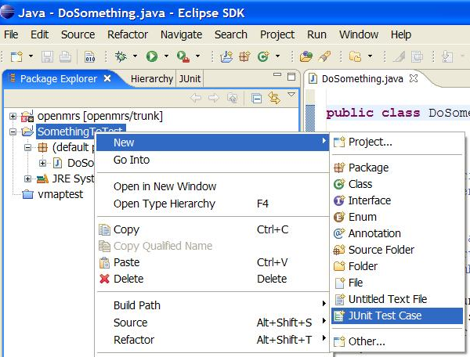
JUnit and Eclipse
To add JUnit to an Eclipse project, click:
Project → Properties → Build Path → Libraries → Add Library... → JUnit → JUnit 5 → Finish
To create a test case:
right-click a file and choose New → Test Case
or click File → New → JUnit Test Case
Eclipse can create stubs of method tests for you.

Slide 22
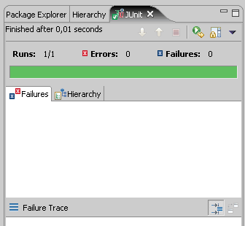
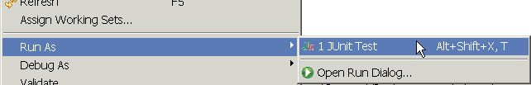
Running a test
Right click it in the Eclipse Package Explorer at left; choose:
Run As → JUnit Test
The JUnit bar will show green if all tests pass, red if any fail.
The Failure Trace shows which tests failed, if any, and why.

Slide 23
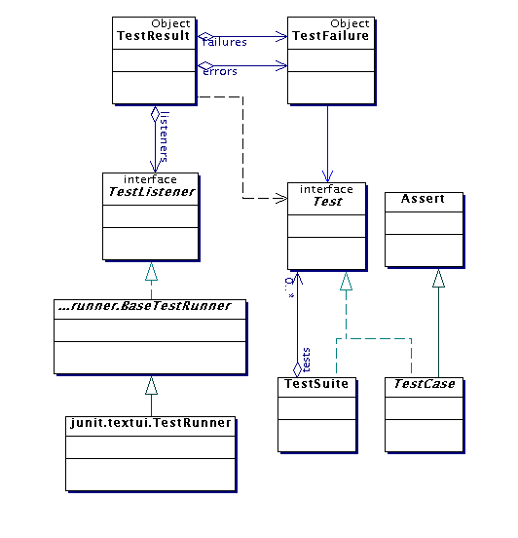
Architectural overview
JUnit test framework is a package of classes that lets you write tests for each method, then easily run those tests
TestRunner runs tests and reports TestResults
You test your class by extending abstract class TestCase
To write test cases, you need to know and understand the Assert class

Slide 24
A JUnit test class
import org.junit.*;
import static org.junit.Assert.*;
// Junit Test Class to test couple of methods in List
public class ListTest {
List<int> list = new ArrayList<int>();
@Test
public void testEmpty(){
assertEquals(0, list.size(), “Size of an empty list should be zero.”);
assertTrue(list.isEmpty(), “An empty bowl should report empty.”);
}
}
A method with @Test is flagged as a JUnit test case.
All @Test methods run when JUnit runs your test class.

Slide 25
Test suites
In practice, you want to run a group of related tests (e.g. all the tests for a class)
To do so, group your test methods in a class which extends TestCase
Running suites we will see in examples

Slide 26
Why create a test suite?
Obviously you have to test your code—right?
You can do ad hoc testing (running whatever tests occur to you at the moment), or
You can build a test suite (a thorough set of tests that can be run at any time)
Disadvantages of a test suite
It’s a lot of extra programming
True, but use of a good test framework can help quite a bit
You don’t have time to do all that extra work
False! Experiments repeatedly show that test suites reduce debugging time more than the amount spent building the test suite
Advantages of a test suite
Reduces total number of bugs in delivered code
Makes code much more maintainable and refactorable

Slide 27
Test suites
test suite: One class that runs many JUnit tests.
An easy way to run all of your app's tests at once.
import org.junit.runner.*;
import org.junit.runners.*;
@RunWith(Suite.class)
@Suite.SuiteClasses({
TestCaseName.class,
TestCaseName.class,
...
TestCaseName.class,
})
public class name {}

Slide 28
Test suite example
import org.junit.runner.*;
import org.junit.runners.*;
@RunWith(Suite.class)
@Suite.SuiteClasses({
WeekdayTest.class,
TimeTest.class,
CourseTest.class,
ScheduleTest.class,
CourseComparatorsTest.class
})
public class HW2Tests {}

Slide 29
Test Suites
import junit.framework.Test;
import junit.framework.TestCase;
import junit.framework.TestSuite;
import example.SimpleTest;
import example.HtmlDocumentTest;
public class AllTests {
static public Test suite() {
TestSuite suite = new TestSuite();
suite.addTestSuite(SimpleTest.class);
suite.addTestSuite(HtmlDocumentTest.class);
return suite;
}
}
Demo

Slide 30

Code Coverage
Code
Coverage
Code coverage is a measure used to describe the degree to which the source code of a program is executed when a particular test suite runs
Code Coverage is classified as a White box testing

Slide 31
Code Coverage Benefits
Code
Coverage
Identify untested part of codebase
Improve the Quality by improved test coverage
Identify the redundant/dead Code
Identify testing gaps or missing tests

Slide 32
Code Coverage Workflow
Code
Coverage
Writing test cases and execute them
Finding areas of code not covered using Code Coverage Tool
Creating additional tests for identified gaps to increase test coverage
Determining a quantitative measure of code coverage

Slide 33
Code Coverage Criteria
Code
Coverage
To measure what percentage of code has been exercised by a test suite, one or more coverage criteria are used
Instructions Coverage
Statements Coverage
Branch Coverage
Method Coverage
Class Coverage

Slide 34
Code Coverage Criteria
Code
Coverage
Report of number of classes from the code base covered
Class Coverage
Method Coverage
Reports whether a method (function) was invoked while testing the application
Branch Coverage
Reports whether Boolean expressions evaluate to true AND false
Statements/Line Coverage
Reports whether each executable statement was executed
Instruction Coverage
Method’s bytecode stream is a sequence of instructions for JVM
The Bytecode for a method are executed when that method is invoked

Slide 35
Code Coverage
Code
Coverage
Method coverage
Branch coverage
Statement coverage
Path coverage

Slide 36
The Emma Code Coverage Tool
Home page:
http://emma.sourceforge.net/
Quick start introduction page:
http://emma.sourceforge.net/intro.html
Download page:
http://sourceforge.net/projects/emma/files/
Emma sample reports page:
http://emma.sourceforge.net/samples.html
Emma FAQ page:
http://emma.sourceforge.net/faq.html

Slide 37
Downloading and Installing Emma
Go to the download page:
http://sourceforge.net/projects/emma/files/
Get the file emma-2.0.5312-lib.zip in the emma-release directory.
The download starts automatically after a short sourceforge advertisement.
Unzip the emma-2.0.5312-lib.zip file and put the file emma.jar in the directory with the code.
You can put the file elsewhere as long as you include the directory in the java class path using the “–cp” option.

Slide 38
Test-driven development
Unit tests can be written after, during, or even before coding.
test-driven development: Write tests, then write code to pass them.
Imagine that we'd like to add a method subtractWeeks to our Date class, that shifts this Date backward in time by the given number of weeks.
Write code to test this method before it has been written.
Then once we do implement the method, we'll know if it works.

